Slide 1

Lane Line Detection using CNN
Team Members:
19B01A0470-K.Vijaya Durga
19B01A04D9-P.Sri Rajya Lakshmi
19B01A0473-K.Madhulika
19B01A0471-K.Manasa
Guided By: Mr.D.Murali Krishna
DEPARTMENT OF ELECTRONICS AND COMMUNICATION ENGINEERING
SHRI VISHNU ENGINEERING COLLEGE FOR WOMEN

Slide 2
Motivation:
The annual increase in car ownerships has caused traffic safety to become an important factor affecting the development of a city. To a large extent, the frequent occurrence of traffic accidents is caused by subjective reasons related to the driver, such as drunk, fatigue and incorrect driving operations. Smart cars can eliminate these human factors to a certain extent.
Based on the driving lane, determining an effective driving direction for the smart car and providing the accurate position of the vehicle in the lane are possible; these features contribute significantly towards improving the efficiency and driving safety of automatic driving .Lane detection is the process of detecting white lines on the roads. Lane tracking is the process of assisting the vehicle to remain in the desired path, and it controls the motion model by using previously detected lane markers.

Slide 3
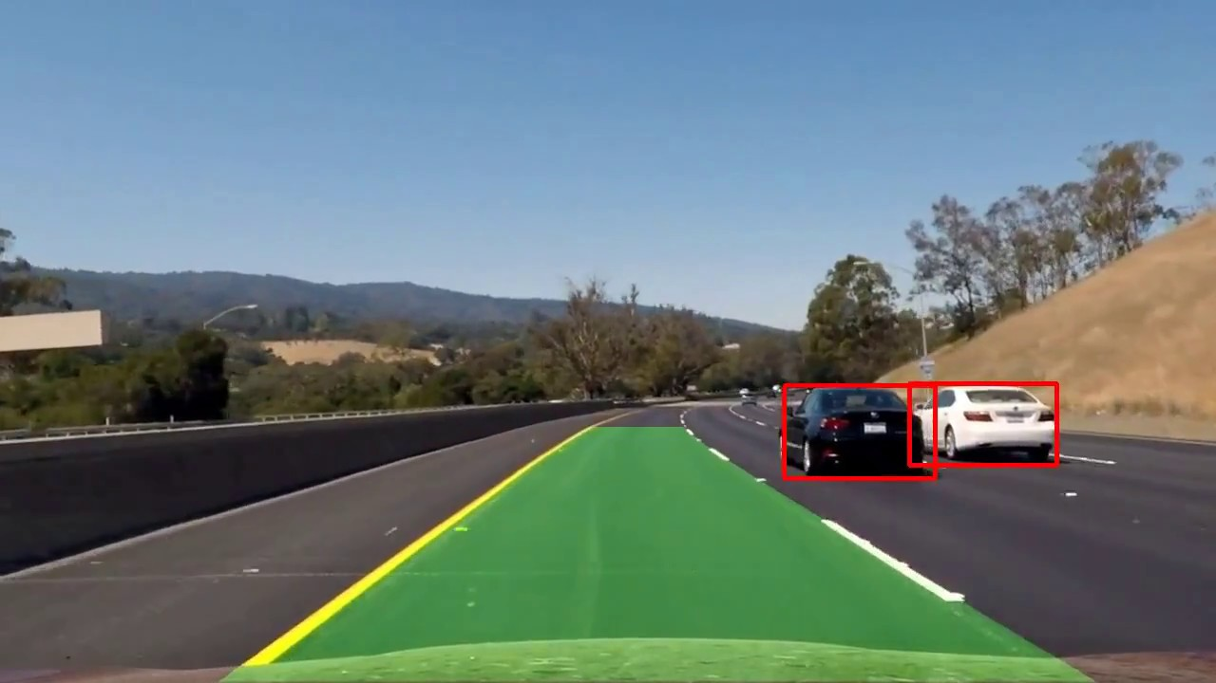
Objectives:
The main aim of this project is to detect lane lines in videos and images of roads using CNN. In this project, we will detect the lane through which the car is moving and we will also detect objects which will be present in the same lane line.
Following lane lines is one of the most important traffic rules, so detecting them is a significant task while building models for autonomous(self-driving) vehicles.
The proposed system would help to used to describe the path for self-driving cars and avoids the risk of getting in another lane
And this system is aimed to operate in a real time environment for enhanced safety by faster acquisition and detecting the lanes to assist the driver in controlling and performing scrutinized operations.

Slide 4
Project Background:
What is Lane Line?
The lines on the road that show us where the lanes are act as our constant reference for where to steer the vehicle. Naturally, one of the first things we would like to do in developing a self-driving car is to automatically detect lane lines using an algorithm.
Why detection of lane lines is important ?
Some roads in rural areas do not have lanes and in winter seasons roads are covered with snow in some areas in such case lane line detection is useful to avoid the increasing accidents and traffic jams. By using CNN algorithm we create a detection software which detects the lane lines and vehicles that are travelling in that lane line.

Slide 5
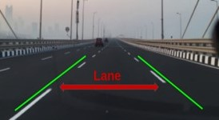
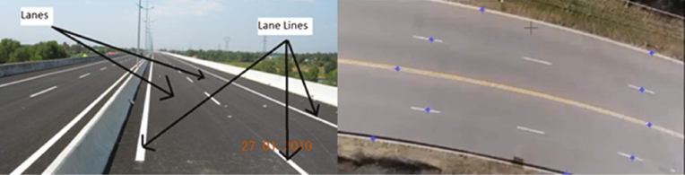
With the rapid development of society, automobiles have become one of the transportation tools for people. As the number of vehicles are increasing day by day, the number of car accidents are increasing every year. Crossing the lane without following proper rules or careless driving are the root causes of most of the accidents. Lane discipline is crucial to road safety for both drivers and pedestrians.
However, there are some roads where lane marks such as white lines are not drawn. Also, when the road is covered with snow, lane marks cannot be seen. In these cases, it's necessary to detect lane line on the road surfaces

Slide 6
Literature Survey:
Y. Wang, L. Shi, J. Lausanne and D. Zhong, "Straight lane line detection based on the Otsu-Canny algorithm," 2022 IEEE 6th Information Technology and Mechatronics Engineering Conference (ITOEC),pp.27-30,2022.
Li Zhipeng, Yu Hongbin and Shao Hongyu, "Research on experiment of road marking detection based on improved Canny edge detection algorithm[J]", Experimental Technology and Management, vol. 36, no. 09, pp. 137-141+148, 2019.
Song Renjie, Liu Chao and Wang Baojun, "Adaptive Canny edge detection algorithm[J]", Journal of Nanjing University of Posts and Telecommunications (Natural Science), vol. 38, no. 03, pp. 72-76, 2018.

Slide 7
Quoc Bao Truong, Byung Ryong Lee, Nam Geon Heo, Young Jim Yum and Jong Gook Kim, "Lane boundaries detection algorithm using vector lane concept," 2008 10th International Conference on Control, Automation, Robotics and Vision, 2008, pp. 2319-2325, doi: 10.1109/ICARCV.2008.4795895.
M. Boumediene, A. Ouamri and N. Dahnoun, "Lane Boundary Detection and Tracking using NNF and HMM Approaches," 2007 IEEE Intelligent Vehicles Symposium, 2007, pp. 1107-1111, doi: 10.1109/IVS.2007.4290265.
Cha-Keon Cheong, "Design of lane detection system based on color classification and edge clustering," 2011 3rd Asia Symposium on Quality Electronic Design (ASQED), 2011, pp. 266-271, doi: 10.1109/ASQED.2011.6111758.

Slide 8
Problem Identification and Proposed Solution:
Limitations of Proposed system :
➢ The existing system detecting lane line based on the Otsu-Canny algorithm
However, we know that otsu -canny algorithm is an image processing algorithm which do not efficiently find out things .
➢ This system is using vector lane concept , NNF and HMM Approaches which does not provide accurate results.
These techniques does only straight lane line detection and does not provide efficient output
Proposed system :
➢ Proposed system determines the polarity (which is positive ,negative or neutral) of the movie review.
➢ Proposed system is applying ML algorithms in sentiment analysis of a movie review which provides more accurate results.
Using Supervised Learning in ML helps in training the data before testing and it uses labelled dataset.

Slide 9
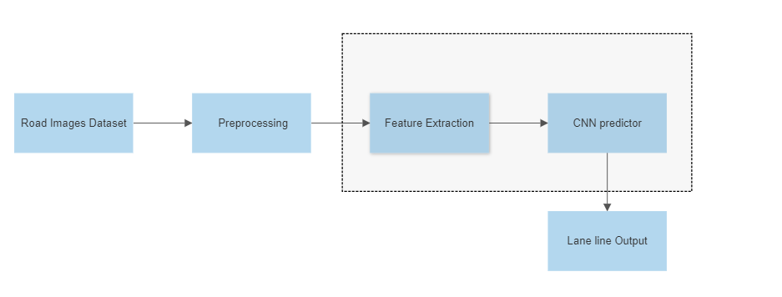
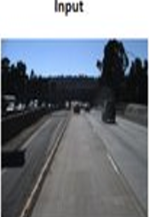
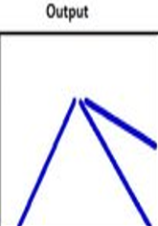
Project Implementation details:
Block Diagram
CNN Architecture

Slide 10
Dataset :
The dataset is taken from kaggle https://www.kaggle.com/columbine/imdb-dataset-sentiment-analysis-in-csv-format
two columns used (text : the review of the movie and label : the sentiment label of the movie review)
Image Pre-Processing :
Image Pre-processing is a crucial step that helps to remove noise and enhance the quality of the image .It involves in extracting meaningful insights from the given input. And It refers to the technique of preparing (i.e., cleaning and organizing)the raw data to make it suitable for a building and training Deep Learning models. There are several techniques used to preprocess image data. Examples include :
Image Resizing
Image enhancement
Denoising
Image augmentation

Slide 11
Feature Extraction :
Feature Extraction is the process of extracting important, non-redundant features from the raw data .And there are many feature extraction techniques such as Bag Of Words ,Tf-Idf Vectorizer ,Doc2vec,etc.. In machine learning, the capability to produce accurate results is influenced by the features used that is why this stage is considered as very important. Here it uses vectorization process and converts arbitrary text into fixed-length vectors by counting how many times each word appears. words that do not occur may possess zeros as value and are defined as sparse.
CNN Predictor :
All these extracted features are stored and passed through the ML Classifiers like logistic regression, decision tree, ensemble, K Nearest Neighbours, Neural network and SVM. Here all these classifiers fall under supervised learning method which helps in training the data before testing and produces best results.here the extracted features are given as input to the classifiers which then determines the polarity of the movie review(i.e., positive, negative, strongly positive, strongly negative or neutral )

Slide 12
Tools Required:
Dataset
Python3 and above
Jupyter Notebook
Windows 7 or above or LINUX or Mac OS

Slide 13
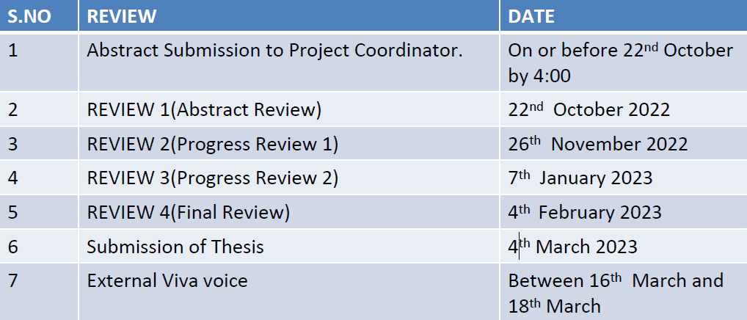
Timeline of Project:

Slide 14
References :
R. Kavya, K. Md Zakir Hussain, N. Nayana, S. S. Savanur, M. Arpitha and R. Srikantaswamy, "Lane Detection and Traffic Sign Recognition from Continuous Driving Scenes using Deep Neural Networks," 2021 2nd International Conference on Smart Electronics and Communication (ICOSEC), 2021, pp. 1461-1467, doi: 10.1109/ICOSEC51865.2021.9591927.
M. R. Islam, T. A. Siddique, M. I. H. Sakib and S. Hossain, "A Convolutional Neural Network for End to End Structural Prediction and Lane Detection for Autonomous Vehicle," 2021 5th International Conference on Electrical Engineering and Information Communication Technology (ICEEICT), 2021, pp. 1-6, doi: 10.1109/ICEEICT53905.2021.9667885..
U. Ozgunalp and N. Dahnoun, "Lane detection based on improved feature map and efficient region of interest extraction," 2015 IEEE Global Conference on Signal and Information Processing (GlobalSIP), 2015, pp. 923-927, doi: 10.1109/GlobalSIP.2015.7418332.

Slide 15
THANK YOU

